Slide 1
Ant
XML based build scripts

Slide 2

Ant
Apache Ant is a software tool for automating software build processes
Similar to MAKE, but:
Written in and developed primarily for Java
Uses XML scripts

Slide 3
Usage
Ant can be run from the command line which means projects can be built without a large IDE such as Eclipse
By default the command line client looks for a build script in the current directory called build.xml, e.g.
If we need to use a different build script, we can specify the path
> ant
> ant -buildfile other.xml

Slide 4
Targets
Build scripts contain targets which are the different jobs that they can perform
We specify the name of the target to run as an argument, e.g.
If we don't specify a target, then the default one will be run, e.g.
> ant compile
> ant

Slide 5
Basic example: project
<?xml version="1.0"?>
<project name="HelloWorld" default="compile">
<target name="clean" description="remove intermediate files">
<delete dir="classes"/>
</target>
<target name="compile" description="compile the Java source files">
<mkdir dir="classes"/>
<javac srcdir="." destdir="classes"/>
</target>
<target name="jar" depends="compile" description="create a Jar file">
<jar destfile="hello.jar">
<fileset dir="classes" includes="**/*.class"/>
<manifest>
<attribute name="Main-Class" value="HelloProgram"/>
</manifest>
</jar>
</target>
</project>
Everything is contained in a project tag

Slide 6
Basic example: targets
<?xml version="1.0"?>
<project name=" HelloWorld" default="compile">
<target name="clean" description="remove intermediate files">
<delete dir="classes"/>
</target>
<target name="compile" description="compile the Java source files">
<mkdir dir="classes"/>
<javac srcdir="." destdir="classes"/>
</target>
<target name="jar" depends="compile" description="create a Jar file">
<jar destfile="hello.jar">
<fileset dir="classes" includes="**/*.class"/>
<manifest>
<attribute name="Main-Class" value="HelloProgram"/>
</manifest>
</jar>
</target>
</project>
Scripts are broken down into targets which are the different jobs that this script can perform

Slide 7

Basic example: tasks
<?xml version="1.0"?>
<project name="HelloWorld" default="compile">
<target name="clean" description="remove intermediate files">
<delete dir="classes"/>
</target>
<target name="compile" description="compile the Java source files">
<mkdir dir="classes"/>
<javac srcdir="." destdir="classes"/>
</target>
<target name="jar" depends="compile" description="create a Jar file">
<jar destfile="hello.jar">
<fileset dir="classes" includes="**/*.class"/>
<manifest>
<attribute name="Main-Class" value="HelloProgram"/>
</manifest>
</jar>
</target>
</project>
Targets are composed of tasks which are built-in functions

Slide 8
build.xml: project
Every ant build file has a project element as its root element
Used to display it in Eclipse etc
The default target to run if none is specified
<?xml version="1.0"?>
<project name="HelloWorld" default="compile">
<description>
Ant build script for the HelloWorld project
</ description >
...
</project>
Optional description element

Slide 9
build.xml: target
Targets are like different jobs that the script can perform, e.g.
Used to display it in Eclipse and choose it from command line
Optional description
<target name="clean" description="remove intermediate files">
<delete dir="classes"/>
</target>
Targets contains tasks like this delete task

Slide 10
Dependencies
Dependencies are relationships between targets, i.e. we can say that the execution of one target depends on the execution of another
For example, we need our compile target to be executed before we can execute the jar target:
<target name="compile" description="compile the Java source files">
...
</target>
<target name="jar" depends="compile" description="create a Jar file">
...
</target>

Slide 11
Properties
String constants can be defined as properties which is good practice for readability and re-usability, e.g.
<property name="classdir" value="classes"/>
<target name="clean" description="remove intermediate files">
<delete dir="${classdir}"/>
</target>

Slide 12

System properties
We can access various predefined system / environment properties in this way as well, e.g.
All environment variables will be imported with this prefix
<property environment="env"/>
<target name="test" description="show path env variable">
<echo message="path = ${env.PATH}"/>
</target>
echo is a built-in task
Use prefix from above

Slide 13

Location properties
If a property is a path then you should use the location attribute as its value will be modified for different file systems, e.g.
<property name="datadir" location="../data/files"/>
<target name="clean-data" description="remove data files">
<delete dir="${datadir}"/>
</target>
On Windows datadir will become "..\data\files"
On Linux datadir will remain as "../data/files"

Slide 14

Time and date properties
Ant also has three predefined properties for getting the current time:
Property | Format | Example Output
${DSTAMP} | yyyyMMdd | 20090725
${TSTAMP} | hhmm | 1605
${TODAY} | MMMM dd yyyy | July 25 2009

Slide 15
Tasks: echo
This simple task writes text, e.g.
We can also write to a file instead of the console, e.g.
A level can be assigned to a message to determine if it should be displayed:
<echo message="Hello world!" />
<echo message="Hello world!" file="msgs.txt" />
<echo message="Hello world!" level="debug" />
Will only be displayed if ant is run with
-debug flag

Slide 16
Tasks: mkdir
This task creates the specified directory and any non-existent parent directories, e.g.
<mkdir dir="project/output/bin/test"/>
Creates the project folder if it doesn't exist, then creates the output folder.. etc

Slide 17
Tasks: delete
This task deletes the specified directory or file, e.g.
<delete file="project/test.java"/>
Deletes the filed called test.java
<delete dir="project/test"/>
Deletes the folder called test and everything inside it

Slide 18
Tasks: javac
This task invokes javac to compile a directory of Java files, e.g.
By default class files will be placed in the same directory, however we can specify the output directory, e.g.
It checks the modified time of each class file and only compile Java files which have been modified since they were last compiled
<javac srcdir="${src.dir}" />
<javac srcdir="${src.dir}" destdir="${classes.dir}" />

Slide 19
Tasks: jar
This task invokes jar to create a JAR file from a directory of class files, e.g.
<jar jarfile="project.jar" basedir="${classes.dir}" />

Slide 20
Tasks: war
This task builds a WAR file from a Java web application project, e.g.
Web app web.xml
<war destfile="myapp.war" webxml="src/metadata/web.xml">
<fileset dir="src/html/myapp"/>
<fileset dir="src/jsp/myapp"/>
<lib dir="libs"/>
<classes dir="build/main" />
</war>
HTML and JSP files
Java classes

Slide 21
Other tasks
For a complete list of built-in tasks see http://ant.apache.org/manual/
You can also write your own tasks
Extend the org.apache.tools.ant.Task
Override the execute method
Provide setter methods for all task attributes
Import the custom task into your build script using <taskdef>, e.g.
<taskdef name="mytask" classname="com.mydomain.MyTask"/>

Slide 22
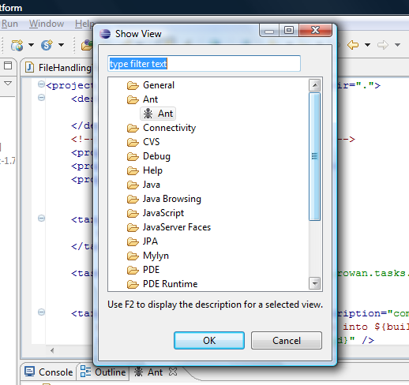
In Eclipse
Window > Show View > Ant

Slide 23
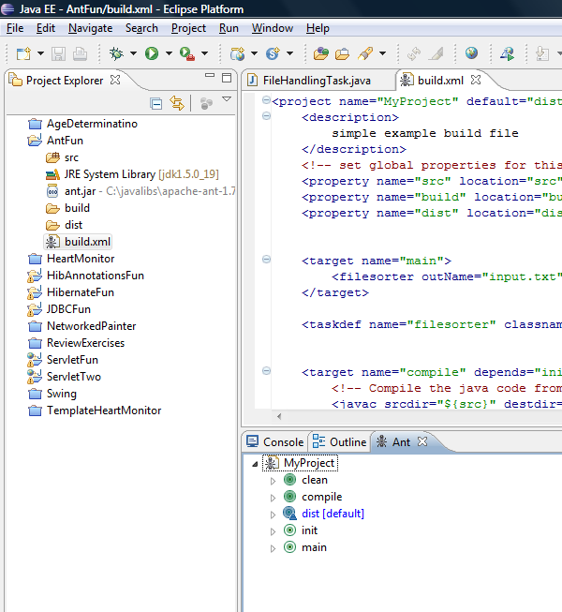
Double-click targets to execute them
Drag build.xml file to Ant view

Slide 24
Resources
Official site: http://ant.apache.org
Manual: http://ant.apache.org/manual/
Tutorial: http://ideoplex.com/focus/java#ant

